Slide 1
Deep Learning in Practice
Organized by Daniel Gordon

Slide 2
What this seminar is
Show off your expertise
If you’ve gotten “x” technique to work in practice
If you’ve not gotten “x” to work even though it is supposed to be straightforward
Show the “correct” way of doing something
See how others are using deep learning techniques
Explore the space of hyperparameters
Network structures
Training techniques
Constants

Slide 3
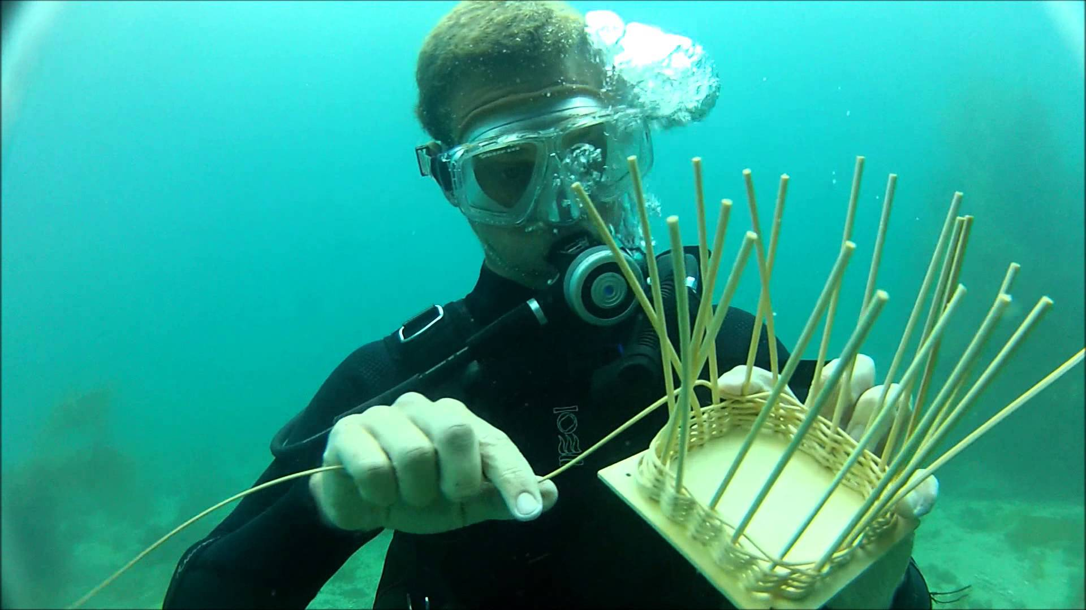
What it’s not
A traditional reading group
If you like an experiment from a paper, feel free to reference it
An actual class taught by an actual professor
Intro to deep learning
Underwater basket weaving

Slide 4
Presenters
Please arrive 10 minutes early so we can set up video conferencing
Please send me your topic choice beforehand
Please send me slides and code after

